Slide 1
Mehran S. Fallah July 2020
Discrete Mathematics
Session XV
Recurrence Relations

Slide 2
Introduction
We introduced recurrence relations in the previous session.
It was also illustrated how one may derive a recurrence relation for a given (combinatorial) problem.
As discussed, there is no general method for solving recurrence relations.
In most cases, one could just try to guess a solution, through examining a number of terms of the given sequence. Then, they may verify the solution using mathematical induction.
Nevertheless, fortunately, there exists a systematic method for solving certain, useful classes of recurrence relations.
In this session, we elaborate on an approach to solving linear homogeneous recurrence relations (LHRRs) with constant coefficients.
We also give an overview of linear algebra so that one can understand the rationale behind the technique for solving LHRRs.

Slide 3
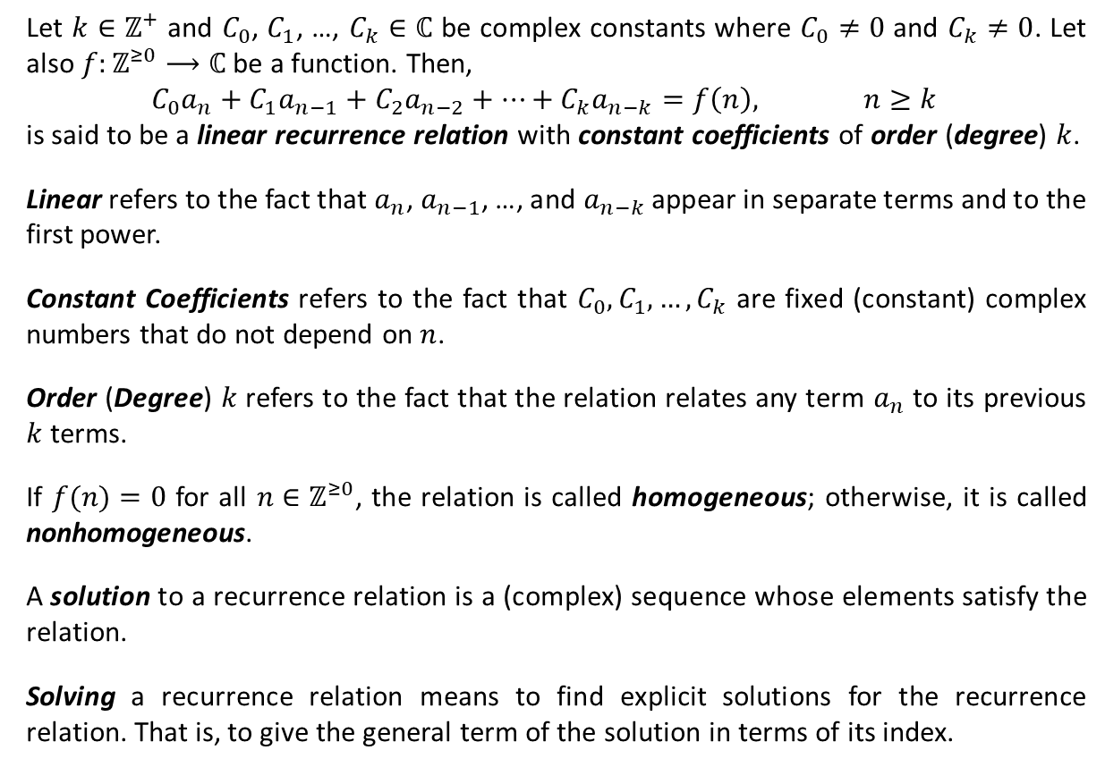
Linear Recurrence Relations
Let $k∈ℤ^{+}$ and $C_{0}$, $C_{1}$, …, $C_{k}∈ℂ$ be complex constants where $C_{0}≠0$ and $C_{k}≠0$. Let also $f:ℤ^{≥0}⟶ℂ$ be a function. Then,
$${C_{0}a}_{n}+C_{1}a_{n−1}+C_{2}a_{n−2}+⋯+C_{k}a_{n−k}=f\left(n\right), n≥k$$
is said to be a linear recurrence relation with constant coefficients of order (degree) $k$.
Linear refers to the fact that $a_{n}$, $a_{n−1}$, …, and $a_{n−k}$ appear in separate terms and to the first power.
Constant Coefficients refers to the fact that $C_{0}, C_{1}, …,C_{k}$ are fixed (constant) complex numbers that do not depend on $n$.
Order (Degree) $k$ refers to the fact that the relation relates any term $a_{n}$ to its previous $k$ terms.
If $f(n)=0$ for all $n∈ℤ^{≥0}$, the relation is called homogeneous; otherwise, it is called nonhomogeneous.
A solution to a recurrence relation is a (complex) sequence whose elements satisfy the relation.
Solving a recurrence relation means to find explicit solutions for the recurrence relation. That is, to give the general term of the solution in terms of its index.

Slide 4






Linear Recurrence Relations (Ctd.)
Consider the following recurrence relations.
$$a_{n}−2a_{n−1}=1+i, n≥1$$
linear
constant coefficients
first-order
nonhomogeneous
$$a_{n}−na_{n−1}=0, n≥1$$
linear
variable coefficients
first-order
homogeneous
$$a_{n}−3.4a_{n−1}=0, n≥1$$
linear
constant coefficients
first-order
homogeneous
$$a_{n}−2a_{n−1}^{2}=0, n≥1$$
nonlinear
first-order
$$a_{n}a_{n−1}=1, n≥1$$
nonlinear
first-order
$$a_{n}−2a_{n−1}+6a_{n−2}=0, n≥2$$
linear
constant coefficients
second-order
homogeneous
$$a_{n}−ia_{n−2}+a_{n−5}=0, n≥5$$
linear
constant coefficients
fifth-order
homogeneous
$$a_{n}−3a_{n−2}+a_{n−5}=2^{n}+3, n≥5$$
linear
constant coefficients
fifth-order
nonhomogeneous

Slide 5
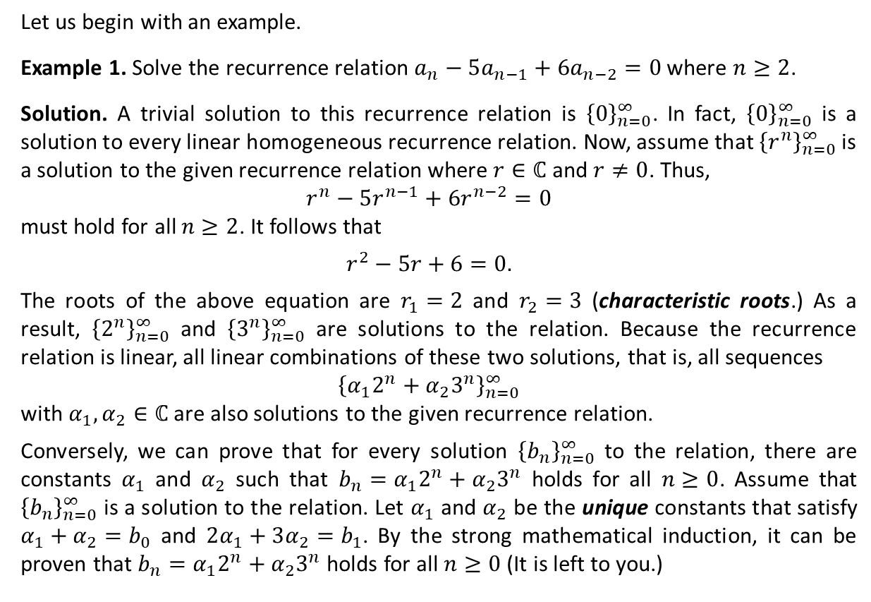
Linear Homogeneous Recurrence Relations (LHRRs) with Constant Coefficients
Let us begin with an example.
Example 1. Solve the recurrence relation $a_{n}−5a_{n−1}+6a_{n−2}=0$ where $n≥2$.
Solution. A trivial solution to this recurrence relation is ${\left\{0\right\}}_{n=0}^{∞}$. In fact, ${\left\{0\right\}}_{n=0}^{∞}$ is a solution to every linear homogeneous recurrence relation. Now, assume that ${\left\{r^{n}\right\}}_{n=0}^{∞}$ is a solution to the given recurrence relation where $r∈ℂ$ and $r≠0$. Thus,
$$r^{n}−5r^{n−1}+6r^{n−2}=0$$
must hold for all $n≥2$. It follows that
$$r^{2}−5r+6=0.$$
The roots of the above equation are $r_{1}=2$ and $r_{2}=3$ (characteristic roots.) As a result, ${\left\{2^{n}\right\}}_{n=0}^{∞}$ and ${\left\{3^{n}\right\}}_{n=0}^{∞}$ are solutions to the relation. Because the recurrence relation is linear, all linear combinations of these two solutions, that is, all sequences
$${\left\{{α_{1}2}^{n}+α_{2}3^{n}\right\}}_{n=0}^{∞}$$
with $α_{1},α_{2}∈ℂ$ are also solutions to the given recurrence relation.
Conversely, we can prove that for every solution ${\left\{b_{n}\right\}}_{n=0}^{∞}$ to the relation, there are constants $α_{1}$ and $α_{2}$ such that $b_{n}=α_{1}2^{n}+α_{2}3^{n}$ holds for all $n≥0$. Assume that ${\left\{b_{n}\right\}}_{n=0}^{∞}$ is a solution to the relation. Let $α_{1}$ and $α_{2}$ be the unique constants that satisfy $α_{1}+α_{2}=b_{0}$ and $2α_{1}+3α_{2}=b_{1}$. By the strong mathematical induction, it can be proven that $b_{n}=α_{1}2^{n}+α_{2}3^{n}$ holds for all $n≥0$ (It is left to you.)
The Characteristic Equation

Slide 6
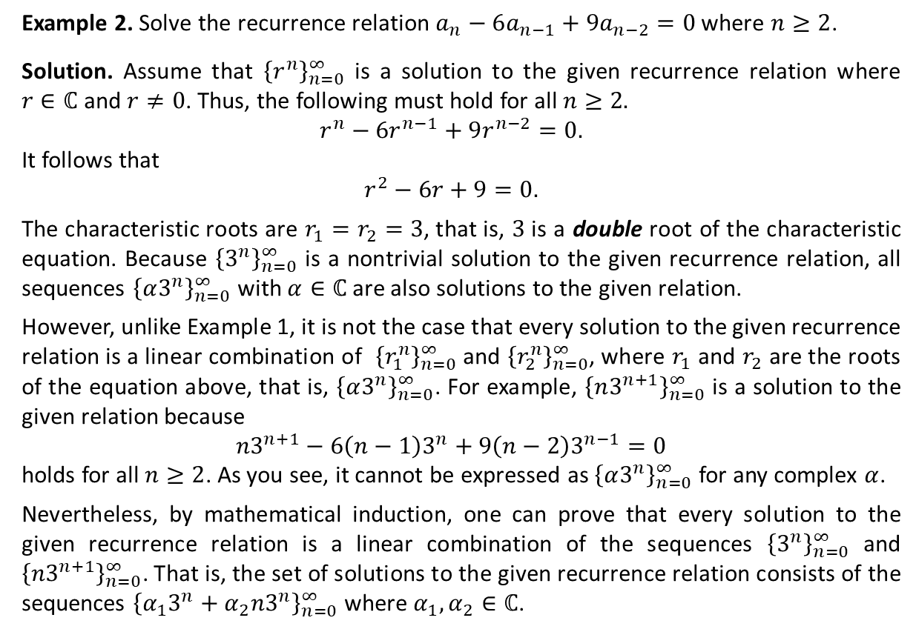
LHRRs with Constant Coefficients (Ctd.)
Example 2. Solve the recurrence relation $a_{n}−6a_{n−1}+9a_{n−2}=0$ where $n≥2$.
Solution. Assume that ${\left\{r^{n}\right\}}_{n=0}^{∞}$ is a solution to the given recurrence relation where $r∈ℂ$ and $r≠0$. Thus, the following must hold for all $n≥2.$
$$r^{n}−6r^{n−1}+9r^{n−2}=0.$$
It follows that
$$r^{2}−6r+9=0.$$
The characteristic roots are $r_{1}=r_{2}=3$, that is, $3$ is a double root of the characteristic equation. Because ${\left\{3^{n}\right\}}_{n=0}^{∞}$ is a nontrivial solution to the given recurrence relation, all sequences ${\left\{α3^{n}\right\}}_{n=0}^{∞}$ with $α∈ℂ$ are also solutions to the given relation.
However, unlike Example 1, it is not the case that every solution to the given recurrence relation is a linear combination of ${\left\{r_{1}^{n}\right\}}_{n=0}^{∞}$ and ${\left\{r_{2}^{n}\right\}}_{n=0}^{∞}$, where $r_{1}$ and $r_{2}$ are the roots of the equation above, that is, ${\left\{α3^{n}\right\}}_{n=0}^{∞}$. For example, ${\left\{n3^{n+1}\right\}}_{n=0}^{∞}$ is a solution to the given relation because
$$n3^{n+1}−6\left(n−1\right)3^{n}+9\left(n−2\right)3^{n−1}=0$$
holds for all $n≥2$. As you see, it cannot be expressed as ${\left\{α3^{n}\right\}}_{n=0}^{∞}$ for any complex $α$.
Nevertheless, by mathematical induction, one can prove that every solution to the given recurrence relation is a linear combination of the sequences ${\left\{3^{n}\right\}}_{n=0}^{∞}$ and ${\left\{n3^{n+1}\right\}}_{n=0}^{∞}$. That is, the set of solutions to the given recurrence relation consists of the sequences ${\left\{α_{1}3^{n}+α_{2}n3^{n}\right\}}_{n=0}^{∞}$ where $α_{1},α_{2}∈ℂ$.

Slide 7


Linear Algebra and LHRRs
Now, we quote some definitions and results from linear algebra.
A vector space over a field $F$ is a set $V$ (the elements of which are called vectors) with an addition $⊕$ and a scalar multiplication $⊙$ satisfying the following properties for all $u,v,w∈V$ and $α,β∈F$:
The set $ℝ^{2}$ of real pairs (the two-dimensional real coordinate space) with the following addition and scalar multiplication is a vector space over $ℝ$ (Why?)
$\left(x,y\right)⊕\left(x^{′},y^{′}\right)=\left(x+x^{′},y+y^{′}\right)$.
$α⊙\left(x,y\right)=(αx,αy)$.
$v⊕w∈V$,
$v⊕w=w⊕v$,
$(u⊕v)⊕w=u⊕(v⊕w)$,
there exists a vector $0$ in $V$ such that $v⊕0=v$,
for each vector $v$ in $V$, there exists a vector $−v$ in $V$ such that $v⊕(−v)=0$,
$α⊙v∈V$
$α⊙(v⊕w)=(α⊙v)⊕(α⊙w)$,
$\left(α+β\right)⊙v =\left(α⊙v\right)⊕(β⊙v)$,
$(α⋅β)⊙v = α⊙(β⊙v)$,
if $1$ is the multiplicative identity of $F$, then $1⊙v=v$.

Slide 8
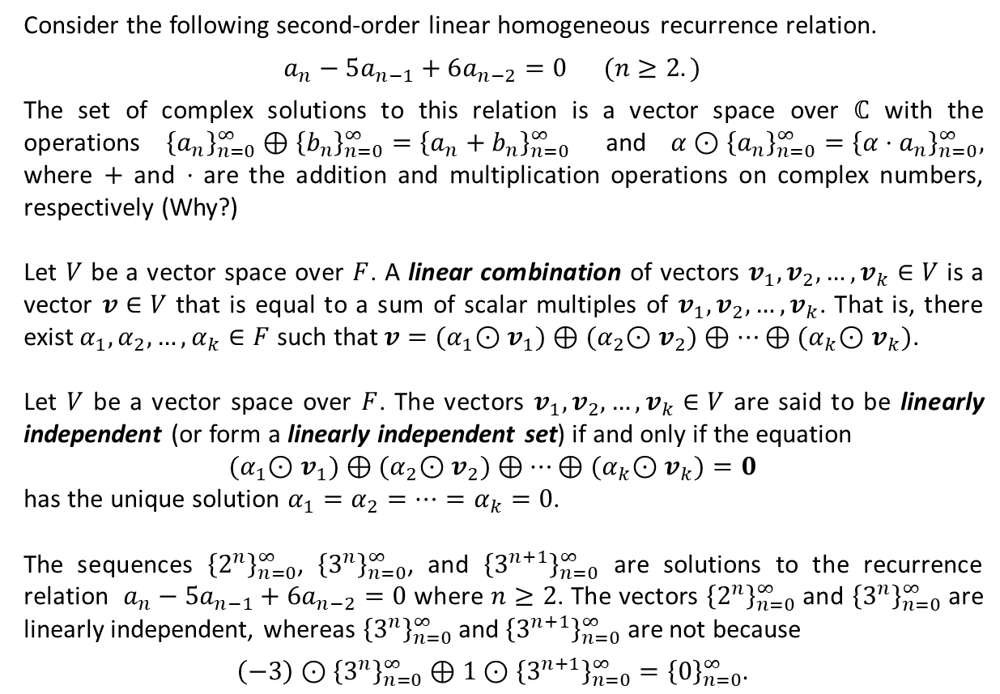
Linear Algebra and LHRRs (Ctd.)
Consider the following second-order linear homogeneous recurrence relation.
$$a_{n}−5a_{n−1}+6a_{n−2}=0 (n≥2.)$$
The set of complex solutions to this relation is a vector space over $ℂ$ with the operations ${\left\{a_{n}\right\}}_{n=0}^{∞}⊕{\left\{b_{n}\right\}}_{n=0}^{∞}={\left\{a_{n}+b_{n}\right\}}_{n=0}^{∞}$ and $α⊙{\left\{a_{n}\right\}}_{n=0}^{∞}={\left\{α⋅a_{n}\right\}}_{n=0}^{∞},$ where $+$ and $⋅$ are the addition and multiplication operations on complex numbers, respectively (Why?)
Let $V$ be a vector space over $F$. A linear combination of vectors $v_{1},v_{2},…,v_{k}∈V$ is a vector $v∈V$ that is equal to a sum of scalar multiples of $v_{1},v_{2},…,v_{k}$. That is, there exist $α_{1},α_{2},…,α_{k}∈F$ such that $v={(α}_{1}⊙v_{1})⊕{(α}_{2}⊙v_{2})⊕⋯⊕{(α}_{k}⊙v_{k})$.
Let $V$ be a vector space over $F$. The vectors $v_{1},v_{2},…,v_{k}∈V$ are said to be linearly independent (or form a linearly independent set) if and only if the equation
$${(α}_{1}⊙v_{1})⊕{(α}_{2}⊙v_{2})⊕⋯⊕{(α}_{k}⊙v_{k})=0$$
has the unique solution $α_{1}=α_{2}=⋯=α_{k}=0$.
The sequences ${\left\{2^{n}\right\}}_{n=0}^{∞}$, ${\left\{3^{n}\right\}}_{n=0}^{∞}$, and ${\left\{3^{n+1}\right\}}_{n=0}^{∞}$ are solutions to the recurrence relation $a_{n}−5a_{n−1}+6a_{n−2}=0$ where $n≥2$. The vectors ${\left\{2^{n}\right\}}_{n=0}^{∞}$ and ${\left\{3^{n}\right\}}_{n=0}^{∞}$ are linearly independent, whereas ${\left\{3^{n}\right\}}_{n=0}^{∞}$ and ${\left\{3^{n+1}\right\}}_{n=0}^{∞}$ are not because
$$\left(−3\right)⊙{\left\{3^{n}\right\}}_{n=0}^{∞}⊕1⊙{\left\{3^{n+1}\right\}}_{n=0}^{∞}={\left\{0\right\}}_{n=0}^{∞}.$$

Slide 9
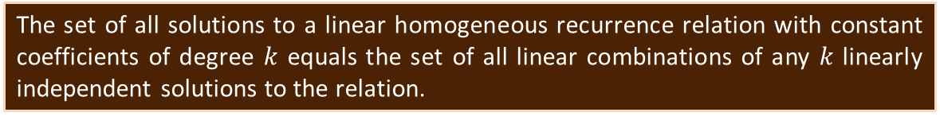

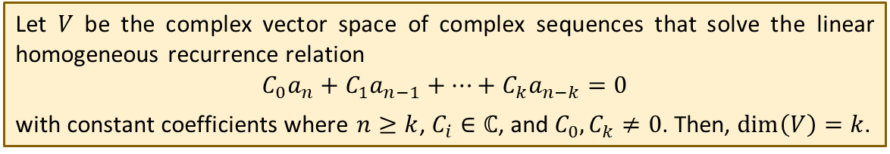
Linear Algebra and LHRRs (Ctd.)
Let $V$ be a vector space over $F$. A subspace $V_{0}$ of $V$ is said to be spanned by the set $S=\left\{v_{1},v_{2},…,v_{k}\right\}⊆V$ iff it consists of all linear combinations of vectors in $S$. That is,
$$V_{0}=\left\{{(α}_{1}⊙v_{1})⊕{(α}_{2}⊙v_{2})⊕⋯⊕{(α}_{k}⊙v_{k}) |{ α}_{1},{ α}_{2}, …,{ α}_{k}∈F\right\}.$$
The set $S$ in the above definition is also said to be a spanning set for the subspace $V_{0}$ of $V$. Moreover, the subspace $V_{0}$ is also denoted by $span\left(S\right)$.
A basis for a vector space $V$ is a linearly independent spanning set for $V$. It is immediate that the number of vectors in all bases for a vector space is the same. The number of vectors in a basis for a vector space is called the dimension of that vector space. The dimension of a vector space $V$ is denoted by $dim⁡(V)$.
Every linearly independent subset $S$ of a vector space $V$ with $\left|S\right|=dim⁡(V)$ is a spanning set for $V$.
Let $V$ be the complex vector space of complex sequences that solve the linear homogeneous recurrence relation
$$C_{0}a_{n}+C_{1}a_{n−1}+…+C_{k}a_{n−k}=0$$
with constant coefficients where $n≥k$, $C_{i}∈ℂ$, and $C_{0},C_{k}≠0$. Then, $\dim\left(V\right)=k$.
The set of all solutions to a linear homogeneous recurrence relation with constant coefficients of degree $k$ equals the set of all linear combinations of any $k$ linearly independent solutions to the relation.

Slide 10
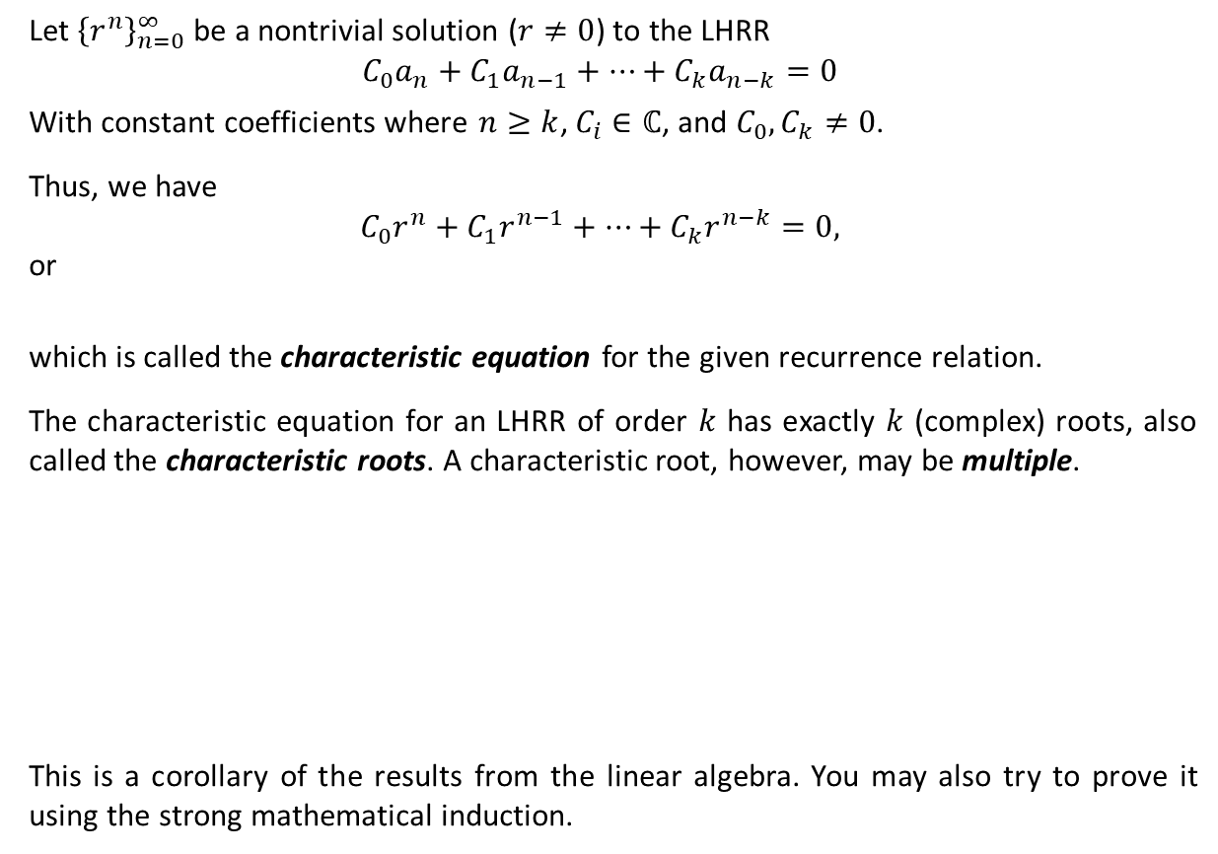
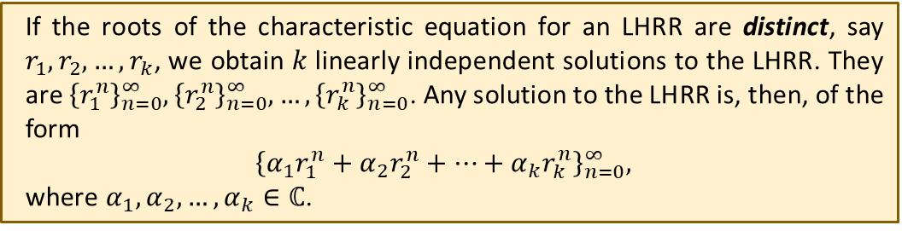

Solving LHRRs with Constant Coefficients
Let ${\left\{r^{n}\right\}}_{n=0}^{∞}$ be a nontrivial solution ($r≠0$) to the LHRR
$$C_{0}a_{n}+C_{1}a_{n−1}+…+C_{k}a_{n−k}=0$$
With constant coefficients where $n≥k$, $C_{i}∈ℂ$, and $C_{0},C_{k}≠0$.
Thus, we have
$$C_{0}r^{n}+C_{1}r^{n−1}+…+C_{k}r^{n−k}=0,$$
or
which is called the characteristic equation for the given recurrence relation.
The characteristic equation for an LHRR of order $k$ has exactly $k$ (complex) roots, also called the characteristic roots. A characteristic root, however, may be multiple.
This is a corollary of the results from the linear algebra. You may also try to prove it using the strong mathematical induction.
$$C_{0}r^{k}+C_{1}r^{k−1}+…+C_{k}=0,$$
If the roots of the characteristic equation for an LHRR are distinct, say $r_{1}, r_{2}, …, r_{k}$, we obtain $k$ linearly independent solutions to the LHRR. They are ${\left\{r_{1}^{n}\right\}}_{n=0}^{∞},{\left\{r_{2}^{n}\right\}}_{n=0}^{∞}, …,{\left\{r_{k}^{n}\right\}}_{n=0}^{∞}$. Any solution to the LHRR is, then, of the form
$${\left\{α_{1}r_{1}^{n}+α_{2}r_{2}^{n}+…+α_{k}r_{k}^{n}\right\}}_{n=0}^{∞},$$
where $α_{1},α_{2},…,α_{k}∈ℂ$.

Slide 11
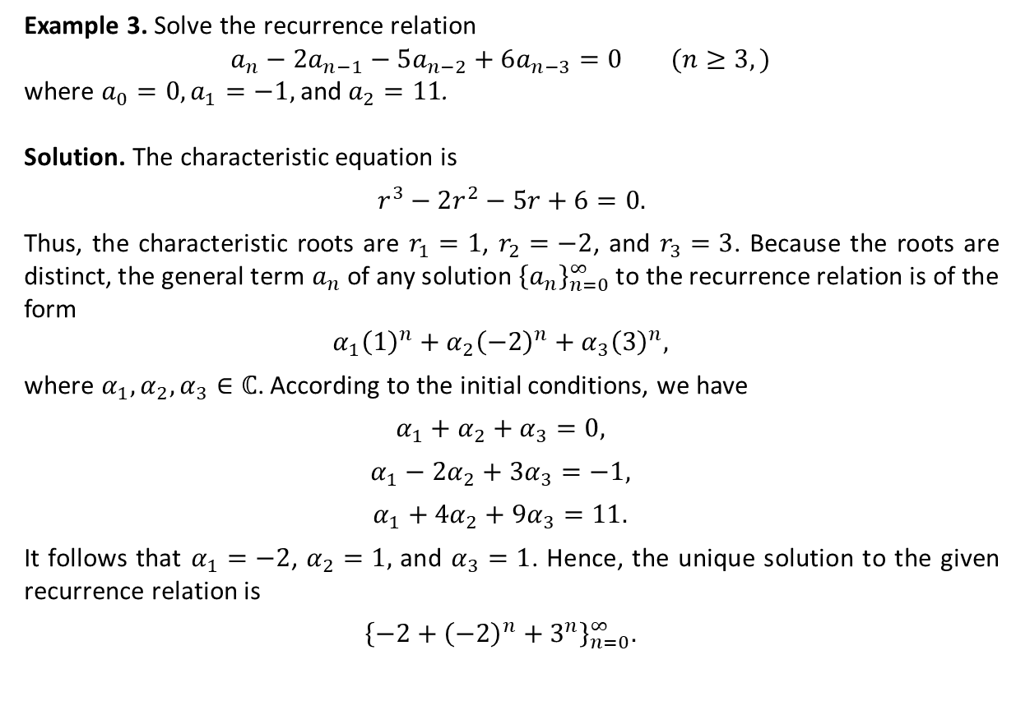
Solving LHRRs with Constant Coefficients: Distinct Characteristic Roots
Example 3. Solve the recurrence relation
$$a_{n}−2a_{n−1}−5a_{n−2}+6a_{n−3}=0 (n≥3,)$$
where $a_{0}=0, a_{1}=−1,$ and $a_{2}=11$.
Solution. The characteristic equation is
$r^{3}−2r^{2}−5r+6=0.$
Thus, the characteristic roots are $r_{1}=1$, $r_{2}=−2$, and $r_{3}=3$. Because the roots are distinct, the general term $a_{n}$ of any solution ${\left\{a_{n}\right\}}_{n=0}^{∞}$ to the recurrence relation is of the form
$$α_{1}{\left(1\right)}^{n}+α_{2}{\left(−2\right)}^{n}+α_{3}{\left(3\right)}^{n},$$
where $α_{1},α_{2},α_{3}∈ℂ$. According to the initial conditions, we have
$$α_{1}+α_{2}+α_{3}=0,$$
$$α_{1}−2α_{2}+{3α}_{3}=−1,$$
$$α_{1}+4α_{2}+9α_{3}=11.$$
It follows that $α_{1}=−2$, $α_{2}=1,$ and $α_{3}=1$. Hence, the unique solution to the given recurrence relation is
$${\left\{−2+{\left(−2\right)}^{n}+3^{n}\right\}}_{n=0}^{∞}.$$

Slide 12
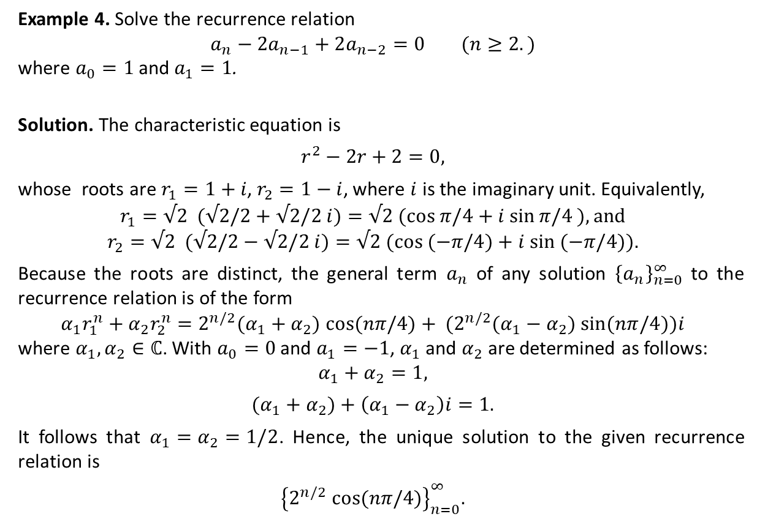
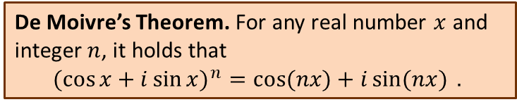
Solving LHRRs with Constant Coefficients: Distinct Characteristic Roots (Ctd.)
De Moivre’s Theorem. For any real number $x$ and integer $n$, it holds that
$$(\cos{x+i{\sin{x)}}^{n}=\cos{(nx)+i\sin{(nx)}} . }$$
Example 4. Solve the recurrence relation
$$a_{n}−2a_{n−1}+2a_{n−2}=0 (n≥2.)$$
where $a_{0}=1$ and $a_{1}=1$.
Solution. The characteristic equation is
$$r^{2}−2r+2=0,$$
whose roots are $r_{1}=1+i$, $r_{2}=1−i$, where $i$ is the imaginary unit. Equivalently,
$$r_{1}=√2 (√2/2+√2/2 i)=√2 (cos π/4+i sin⁡π/4 ), and$$
$$r_{2}=√2 (√2/2−√2/2 i)=√2 (cos (−π/4)+i sin⁡ (−π/4)).$$
Because the roots are distinct, the general term $a_{n}$ of any solution ${\left\{a_{n}\right\}}_{n=0}^{∞}$ to the recurrence relation is of the form
$$α_{1}r_{1}^{n}+α_{2}r_{2}^{n}=2^{n/2}(α_{1}+α_{2}) cos⁡(nπ/4)+ (2^{n/2}(α_{1}−α_{2}) sin⁡(nπ/4))i$$
where $α_{1},α_{2}∈ℂ$. With $a_{0}=0$ and $a_{1}=−1$, $α_{1}$ and $α_{2}$ are determined as follows:
$$α_{1}+α_{2}=1,$$
$$(α_{1}+α_{2})+\left(α_{1}−α_{2}\right)i=1.$$
It follows that $α_{1}=α_{2}=1/2$. Hence, the unique solution to the given recurrence relation is
$${\left\{2^{n/2} cos⁡(nπ/4)\right\}}_{n=0}^{∞}.$$

Slide 13
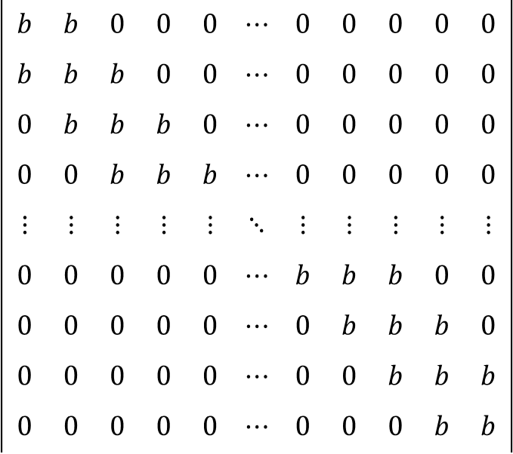
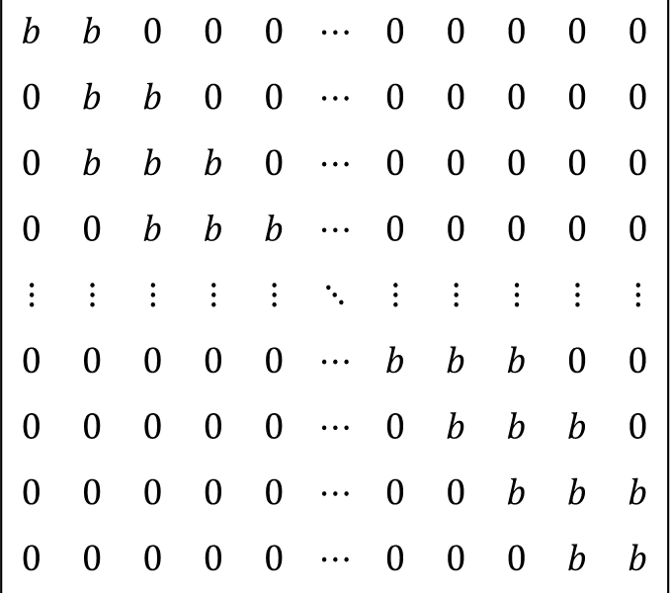






Solving LHRRs with Constant Coefficients: Distinct Characteristic Roots (Ctd.)
Example 5. For $b∈ℝ^{+}$, find the determinant $D_{n}$ of the following $n×n$ tridiagonal matrix
solution. It is immediate that $D_{1}=\left|b\right|=b$ and $D_{2}=\left|\begin{matrix}b & b \\ b & b\end{matrix}\right|=0$. For $n≥3$, expanding $D_{n}$ by its first row, we have
$$D_{n}=$$
$$bD_{n−1}$$
$$− b$$
$$=bD_{n−1}−b(bD_{n−2})$$
$$D_{n}−bD_{n−1}+b^{2}D_{n−2}=0$$

Slide 14
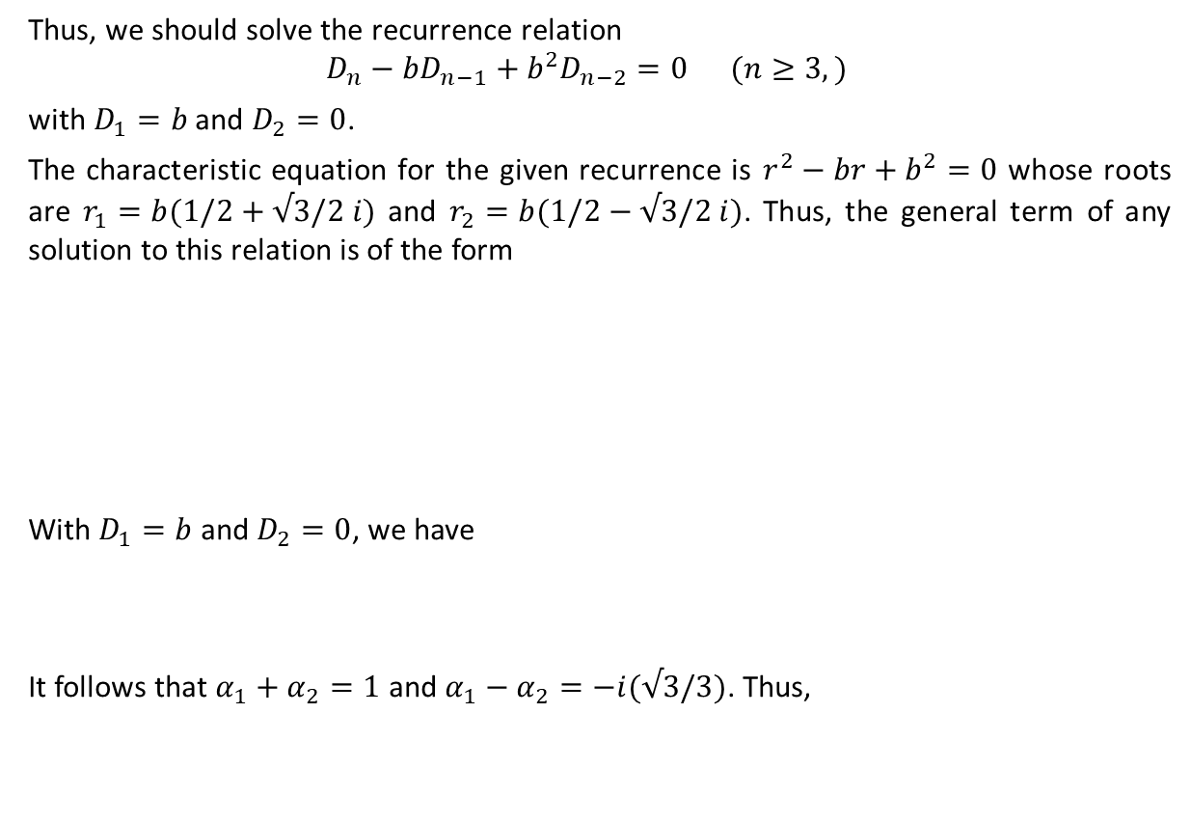


Solving LHRRs with Constant Coefficients: Distinct Characteristic Roots (Ctd.)
Thus, we should solve the recurrence relation
$$D_{n}−bD_{n−1}+b^{2}D_{n−2}=0 (n≥3,)$$
with $D_{1}=b$ and $D_{2}=0$.
The characteristic equation for the given recurrence is $r^{2}−br+b^{2}=0$ whose roots are $r_{1}=b(1/2+√3/2 i)$ and $r_{2}=b(1/2−√3/2 i)$. Thus, the general term of any solution to this relation is of the form
With $D_{1}=b$ and $D_{2}=0$, we have
It follows that $α_{1}+α_{2}=1$ and $α_{1}−α_{2}=−i(√3/3)$. Thus,
$${D_{n}=α}_{1}r_{1}^{n}+α_{2}r_{2}^{n}$$
$$=α_{1}b^{n}{\left(cos⁡(π/3)+i sin⁡(π/3)\right)}^{n}+α_{2}b^{n}{\left(cos⁡(−π/3)+i sin⁡(−π/3)\right)}^{n}$$
$$=α_{1}b^{n}\left(cos⁡(nπ/3)+i sin⁡(nπ/3)\right)+α_{2}b^{n}\left(cos⁡(nπ/3)−i sin⁡(nπ/3)\right)$$
$$={(α}_{1} {+ α}_{2})b^{n}cos⁡(nπ/3)+i{(α_{1}−α}_{2})b^{n}sin⁡(nπ/3)$$
$$(1/2)(α_{1}+α_{2})b+i{(√3/2)(α_{1}−α}_{2})b=b$$
$$\left(−1/2\right)\left(α_{1}+α_{2}\right)b^{2}+i{(√3/2)(α_{1}−α}_{2})b^{2}=0$$
$$D_{n}=b^{n}\left(\cos\left(nπ/3\right)+\left(√3/3\right)\sin\left(nπ/3\right)\right).$$

Slide 15


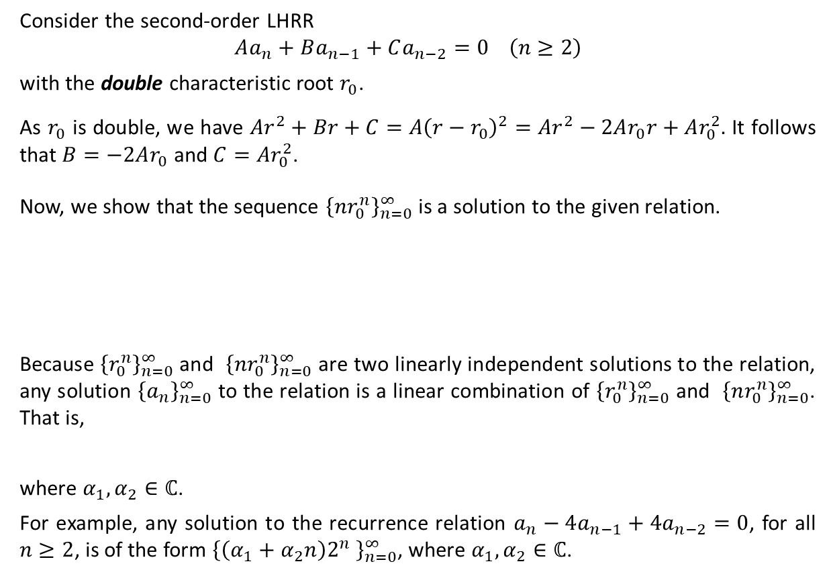

Solving LHRRs with Constant Coefficients: Multiple Characteristic Roots
Consider the second-order LHRR
$$Aa_{n}+Ba_{n−1}+Ca_{n−2}=0 \left(n≥2\right)$$
with the double characteristic root $r_{0}$.
As $r_{0}$ is double, we have $Ar^{2}+Br+C=A{\left(r−r_{0}\right)}^{2}=Ar^{2}−2Ar_{0}r+Ar_{0}^{2}.$ It follows that $B=−2Ar_{0}$ and $C=Ar_{0}^{2}$.
Now, we show that the sequence ${\left\{nr_{0}^{n}\right\}}_{n=0}^{∞}$ is a solution to the given relation.
Because ${\left\{r_{0}^{n}\right\}}_{n=0}^{∞}$ and ${\left\{nr_{0}^{n}\right\}}_{n=0}^{∞}$ are two linearly independent solutions to the relation, any solution ${\left\{a_{n}\right\}}_{n=0}^{∞}$ to the relation is a linear combination of ${\left\{r_{0}^{n}\right\}}_{n=0}^{∞}$ and ${\left\{nr_{0}^{n}\right\}}_{n=0}^{∞}$. That is,
where $α_{1},α_{2}∈ℂ$.
For example, any solution to the recurrence relation $a_{n}−4a_{n−1}+4a_{n−2}=0$, for all $n≥2$, is of the form ${\left\{\left(α_{1}+α_{2}n\right)2^{n} \right\}}_{n=0}^{∞}$, where $α_{1},α_{2}∈ℂ$.
$$Anr_{0}^{n}+B\left(n−1\right)r_{0}^{n−1}+C\left(n−2\right)r_{0}^{n−2}$$
$$=n\left(Ar_{0}^{n}+Br_{0}^{n−1}+Cr_{0}^{n−2}\right)−Br_{0}^{n−1}−2Cr_{0}^{n−2}$$
$$=0−r_{0}^{n−2}(Br_{0}+2C)$$
$=r_{0}^{n−2}(2Ar_{0}^{2}−2Ar_{0}^{2})$
$$=0$$
$${\left\{a_{n}\right\}}_{n=0}^{∞}={\left\{α_{1}r_{0}^{n}+α_{2}nr_{0}^{n}\right\}}_{n=0}^{∞}={\left\{(α_{1}+α_{2}n)r_{0}^{n}\right\}}_{n=0}^{∞},$$

Slide 16

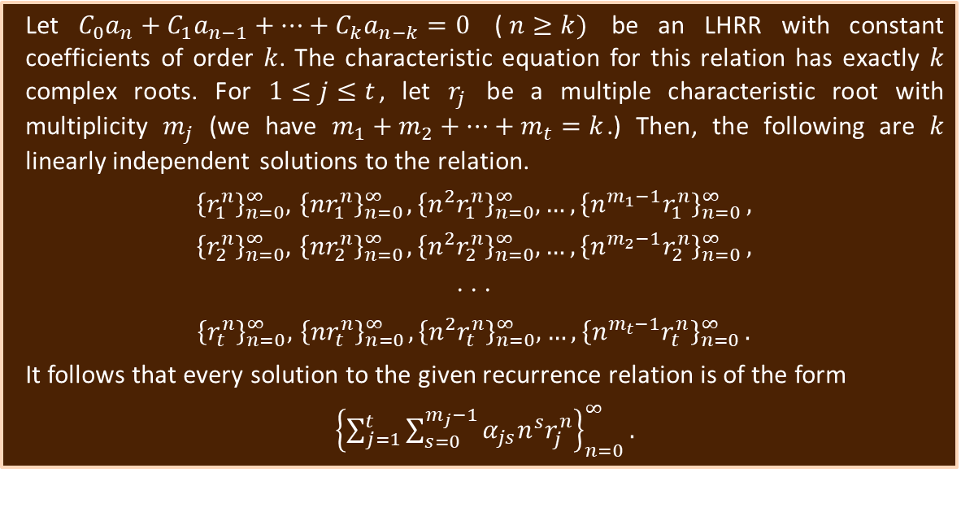
Solving LHRRs with Constant Coefficients: Multiple Characteristic Roots (Ctd.)
Using the same technique, one can prove that ${\left\{nr_{0}^{n}\right\}}_{n=0}^{∞}$ and ${\left\{n^{2}r_{0}^{n}\right\}}_{n=0}^{∞}$ are solutions to the recurrence relation
$$Aa_{n}+Ba_{n−1}+Ca_{n−2}+Da_{n−3}=0 \left(n≥3\right)$$
if $r_{0}$ is a triple characteristic root (It is left to you as an exercise.)
The above results can be generalized as follows:
Let $C_{0}a_{n}+C_{1}a_{n−1}+…+C_{k}a_{n−k}=0$ ($n≥k)$ be an LHRR with constant coefficients of order $k$. The characteristic equation for this relation has exactly $k$ complex roots. For $1≤j≤t$, let $r_{j}$ be a multiple characteristic root with multiplicity $m_{j}$ (we have $m_{1}+m_{2}+…+m_{t}=k$.) Then, the following are $k$ linearly independent solutions to the relation.
$${\left\{r_{1}^{n}\right\}}_{n=0}^{∞},{ \left\{{nr}_{1}^{n}\right\}}_{n=0}^{∞}, {\left\{n^{2}r_{1}^{n}\right\}}_{n=0}^{∞},{…,\left\{n^{m_{1}−1}r_{1}^{n}\right\}}_{n=0}^{∞},$$
$${\left\{r_{2}^{n}\right\}}_{n=0}^{∞},{ \left\{{nr}_{2}^{n}\right\}}_{n=0}^{∞}, {\left\{n^{2}r_{2}^{n}\right\}}_{n=0}^{∞},{…,\left\{n^{m_{2}−1}r_{2}^{n}\right\}}_{n=0}^{∞},$$
$$⋅ ⋅ ⋅$$
$${\left\{r_{t}^{n}\right\}}_{n=0}^{∞},{ \left\{{nr}_{t}^{n}\right\}}_{n=0}^{∞}, {\left\{n^{2}r_{t}^{n}\right\}}_{n=0}^{∞},{…,\left\{n^{m_{t}−1}r_{t}^{n}\right\}}_{n=0}^{∞}.$$
It follows that every solution to the given recurrence relation is of the form
${\left\{\sum_{j=1}^{t}{\sum_{s=0}^{m_{j}−1}{α_{js}{n^{s}r}_{j}^{n}}}\right\}}_{n=0}^{∞}.$

Slide 17
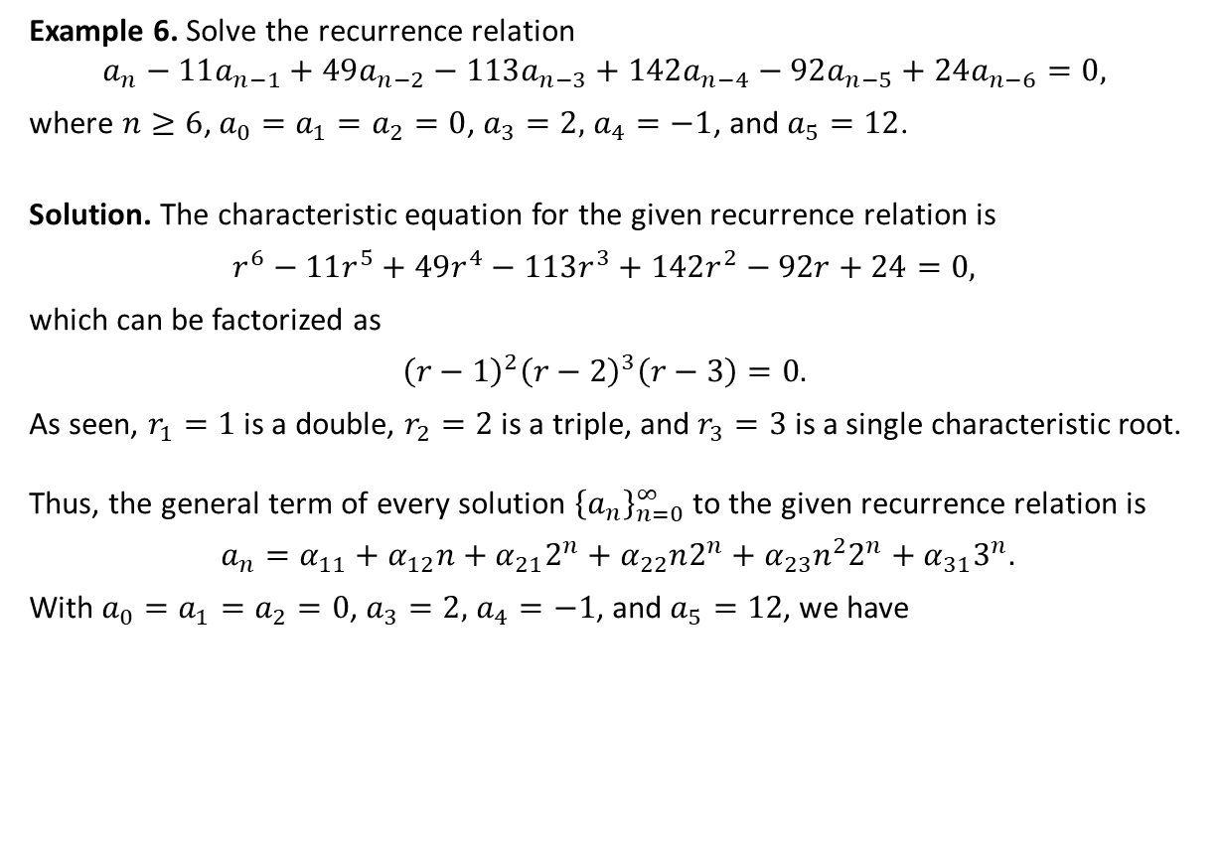
Solving LHRRs with Constant Coefficients: Multiple Characteristic Roots (Ctd.)
Example 6. Solve the recurrence relation
$$a_{n}−11a_{n−1}+49a_{n−2}−113a_{n−3}+142a_{n−4}−92a_{n−5}+24a_{n−6}=0,$$
where $n≥6$, $a_{0}=a_{1}=a_{2}=0$, $a_{3}=2,$ $a_{4}=−1$, and $a_{5}=12$.
Solution. The characteristic equation for the given recurrence relation is
$$r^{6}−11r^{5}+49r^{4}−113r^{3}+142r^{2}−92r+24=0,$$
which can be factorized as
$${\left(r−1\right)}^{2}{\left(r−2\right)}^{3}\left(r−3\right)=0.$$
As seen, $r_{1}=1$ is a double, $r_{2}=2$ is a triple, and $r_{3}=3$ is a single characteristic root.
Thus, the general term of every solution ${\left\{a_{n}\right\}}_{n=0}^{∞}$ to the given recurrence relation is
$a_{n}=α_{11}+α_{12}n+α_{21}2^{n}+α_{22}n2^{n}+α_{23}n^{2}2^{n}+α_{31}3^{n}.$
With $a_{0}=a_{1}=a_{2}=0$, $a_{3}=2,$ $a_{4}=−1$, and $a_{5}=12$, we have
$${\left\{a_{n}\right\}}_{n=0}^{∞}=\{\left(−92.256\right)+\left(−53.103\right)n+{\left(100.532\right)2}^{n}$$
$${+(−30.840)n2^{n}+(2.513)n^{2}2^{n}+{\left(0.316\right)3}^{n}\}}_{n=0}^{∞}$$

Slide 18
Textbook: Ralph P. Grimaldi, Discrete and Combinatorial Mathematics
Please consult with Chapter 10 of your textbook.

